Slide 1


Isha Desai
07/03/2024

Slide 2

Outline
Executive Summary
Introduction
Methodology
Results
Conclusion
Appendix

Slide 3
Executive Summary
Summary of methodologies
Data Collection through API
Data Collection with Web Scraping
Data Wrangling
Exploratory Data Analysis with SQL
Exploratory Data Analysis with Data Visualization
Interactive Visual Analytics with Folium
Machine Learning Prediction
Summary of all results
Results obtained from the Exploratory Data Analysis
Data visualization’s outputs
Predictive Analytics result

Slide 4
Introduction
Project background and context
In this capstone, we will predict if the Falcon 9 first stage will land successfully. SpaceX advertises Falcon 9 rocket launches on its website with a cost of 62 million dollars; other providers cost upward of 165 million dollars each, much of the savings is because SpaceX can reuse the first stage. Therefore if we can determine if the first stage will land, we can determine the cost of a launch. This information can be used if an alternate company wants to bid against SpaceX for a rocket launch.
Problems you want to find answers
What factors determine if the rocket will land successfully?
The interaction amongst various features that determine the success rate of a successful landing.
What operating conditions needs to be in place to ensure a successful landing program.

Slide 5

Section 1

Slide 6
Methodology
Executive Summary
Data collection methodology:
Data was collected using SpaceX API and web scraping from Wikipedia.
Perform data wrangling
One-hot encoding was applied to categorical features
Perform exploratory data analysis (EDA) using visualization and SQL
Perform interactive visual analytics using Folium and Plotly Dash
Perform predictive analysis using classification models
How to build, tune, evaluate classification models

Slide 7
Data Collection
Describe how data sets were collected.
The data was collected using the SpaceX API.
The to content was converted to Json using .json() function call and then into a pandas data frame using .json_normalize().
We then checked the data for missing values and filled in missing values where ever necessary.
Data was scraped from the web (Wikipedia for Falcon 9 launch records) with BeautifulSoup.
The data was extracted as HTML tables, it was then parsed and converted to a pandas dataframe for further analysis.

Slide 8
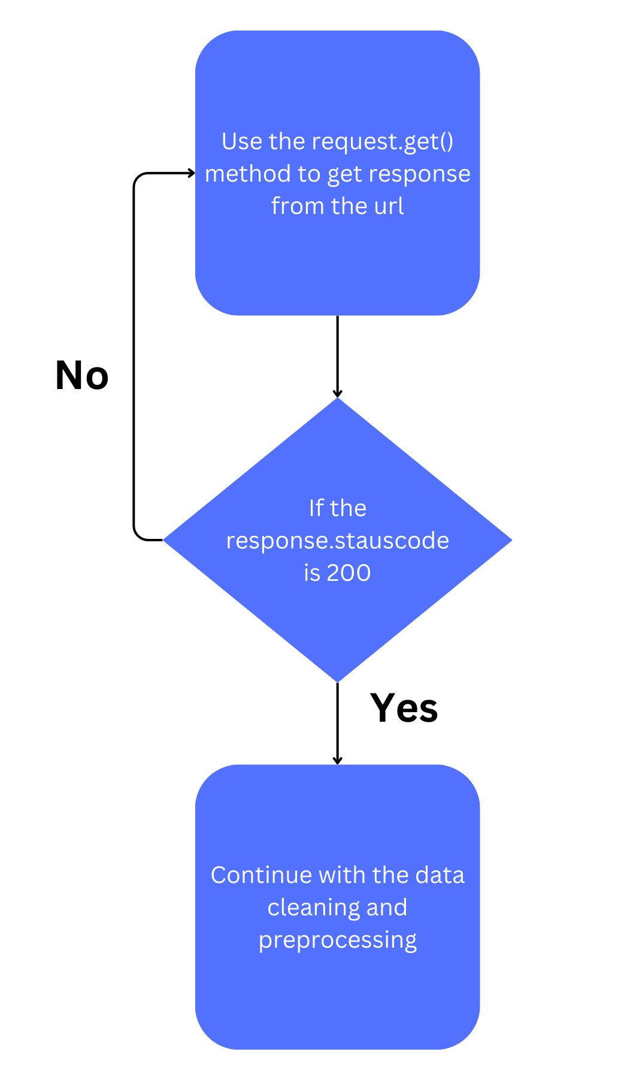
Data Collection – SpaceX API
The get request was used to collect data from the SpaceX API url.
The collected data was cleaned and filtered using basic data cleaning techniques.
The link to the notebook is https://github.com/ISHA-2112/IBM-CAPSTONE-PROJECT-ISHADESAI/blob/main/jupyter-labs-spacex-data-collection-api.ipynb

Slide 9
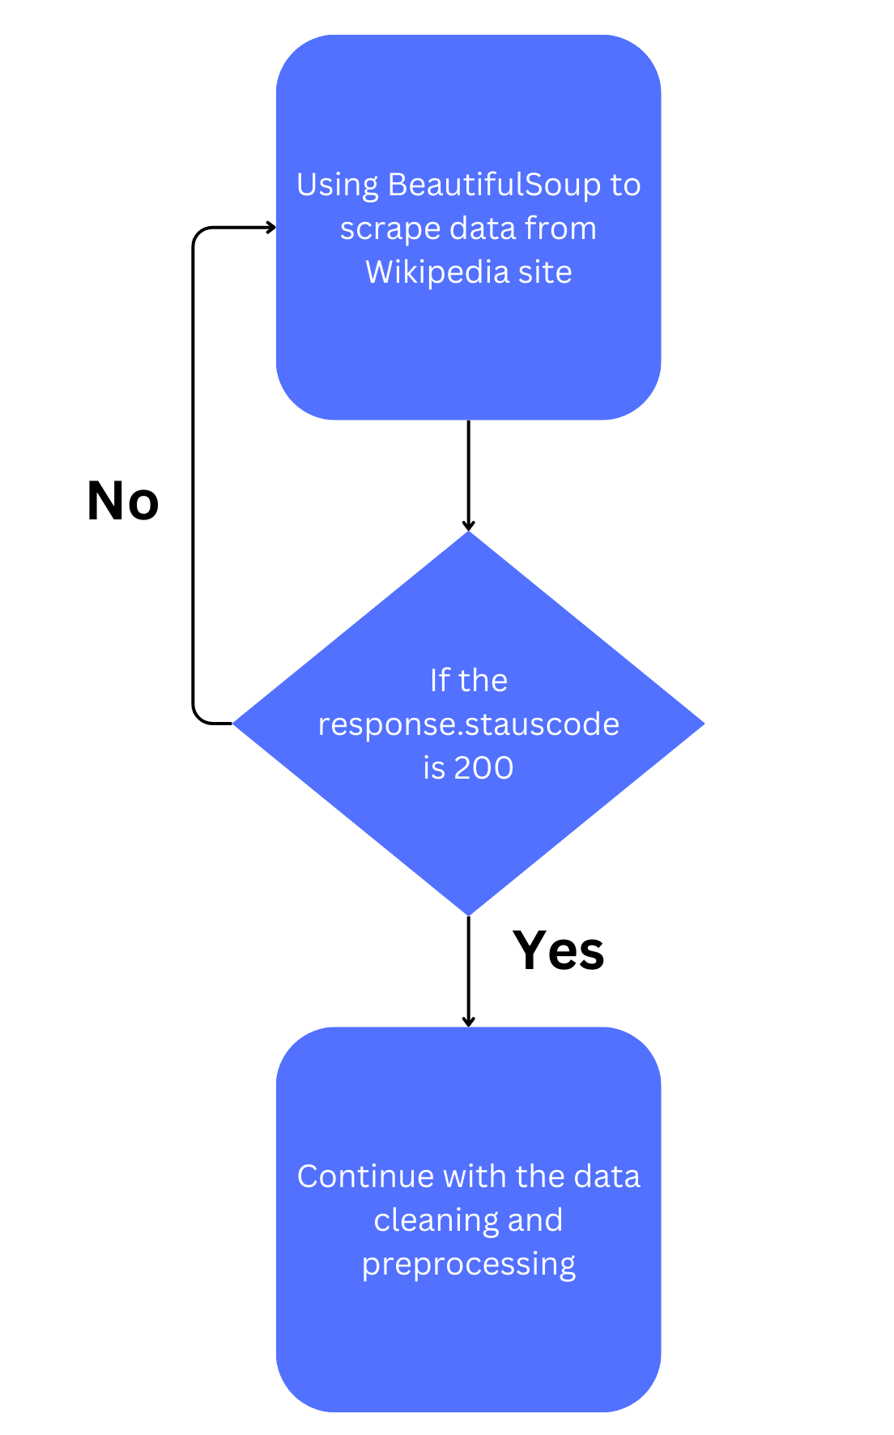
Data Collection - Scraping
The data was scraped from web using BeautifulSoup.
Wikipedia page was used as the source of the data.
The data was collected as a html table which was converted into a pandas dataframe.
The link to the notebook is https://github.com/ISHA-2112/IBM-CAPSTONE-PROJECT-ISHADESAI/blob/main/jupyter-labs-webscraping.ipynb

Slide 10
Data Wrangling
Exploratory data analysis is performed and the training labels are determined.
The number of launches at each site, and the number and occurrence of each orbits are counted.
Landing outcome label from outcome column is created and the results are exported to csv file.
The link to the notebook is:
https://github.com/ISHA-2112/IBM-CAPSTONE-PROJECT-ISHADESAI/blob/main/labs-jupyter-spacex-Data%20wrangling.ipynb

Slide 11
EDA with Data Visualization
Data visualization is used to analyze the following relationships:
Flight Number And Launch Site
Payload And Launch Site
Success Rate Of Each Orbit Type
Flight Number And Orbit Type
The Launch Success Yearly Trend.
Link to the notebook:
https://github.com/ISHA-2112/IBM-CAPSTONE-PROJECT-ISHADESAI/blob/main/jupyter-labs-eda-dataviz.ipynb.jupyterlite.ipynb

Slide 12
EDA with SQL
The SpaceX dataset is loaded into the PostgreSQL database.
SQL is used to get the following insight:
The names of unique launch sites in the space mission.
The total payload mass carried by boosters launched by NASA (CRS)
The average payload mass carried by booster version F9 v1.1
The total number of successful and failure mission outcomes
The failed landing outcomes in drone ship, their booster version and launch site names.
Link to the notebook:
https://github.com/ISHA-2112/IBM-CAPSTONE-PROJECT-ISHADESAI/blob/main/jupyter-labs-eda-sql-coursera_sqllite.ipynb

Slide 13
Build an Interactive Map with Folium
All launch sites are marked, and map objects such as markers, circles, lines to mark the success or failure of launches for each site are added on the folium map.
Using the color-labeled marker clusters, the launch sites having relatively high success rates can be identified.
The distances between a launch site to its proximities are calculated.
The following inferences are drawn:
Are launch sites near railways, highways and coastlines.
Do launch sites keep certain distance away from cities.
Link to notebook:
https://github.com/ISHA-2112/IBM-CAPSTONE-PROJECT-ISHADESAI/blob/main/lab_jupyter_launch_site_location.jupyterlite.ipynb

Slide 14
Build a Dashboard with Plotly Dash
An interactive dashboard was built using Plotly dash
The following plots were plotted and inferences were drawn:
pie charts showing the total launches by a certain sites
scatter graph showing the relationship with Outcome and Payload Mass (Kg) for the different booster version.
Link to code:
https://github.com/ISHA-2112/IBM-CAPSTONE-PROJECT-ISHADESAI/blob/main/spacex_dash_app.py

Slide 15
Predictive Analysis (Classification)
Numpy and pandas is used to load data, transform and split the data into training and testing.
Different machine learning models are built and different hyperparametersare tuned using GridSearchCV.
Feature engineering and algorithm tuning is used to improve model accuracy.
The link to the notebook is
https://github.com/ISHA-2112/IBM-CAPSTONE-PROJECT-ISHADESAI/blob/main/SpaceX_Machine_Learning_Prediction_Part_5.jupyterlite.ipynb

Slide 16
Results
Exploratory data analysis results
Interactive analytics demo in screenshots
Predictive analysis results

Slide 17

Section 2

Slide 18

Flight Number vs. Launch Site
From the plot, we found that the larger the flight amount at a launch site, the greater the success rate at a launch site.
18

Slide 19

Payload vs. Launch Site
Greater the payload mass for launch site CCAFS SLC 40 higher the success rate for the rocket
19

Slide 20

Success Rate vs. Orbit Type
From the plot, we can see that ES-L1, GEO, HEO, SSO, VLEO had the most success rate.

Slide 21

Flight Number vs. Orbit Type
The plot below shows the Flight Number vs. Orbit type. We observe that in the LEO orbit, success is related to the number of flights whereas in the GTO orbit, there is no relationship between flight number and the orbit.

Slide 22

Payload vs. Orbit Type
We can observe that with heavy payloads, the successful landing are more for PO, LEO and ISS orbits.

Slide 23

Launch Success Yearly Trend
From the plot, we can observe that success rate since 2013 kept on increasing till 2020.

Slide 24

All Launch Site Names
We used the key word DISTINCT to show only unique launch sites from the SpaceX data.

Slide 25

Launch Site Names Begin with 'CCA'
We used the query above to display 5 records where launch sites begin with `CCA`

Slide 26

Total Payload Mass
We calculated the total payload carried by boosters from NASA as 45596 using the query below

Slide 27

Average Payload Mass by F9 v1.1
We calculated the average payload mass carried by booster version F9 v1.1 as 2928.4

Slide 28

First Successful Ground Landing Date
We observed that the dates of the first successful landing outcome on ground pad was 22nd December 2015

Slide 29

Successful Drone Ship Landing with Payload between 4000 and 6000
We used the WHERE clause to filter for boosters which have successfully landed on drone ship and applied the AND condition to determine successful landing with payload mass greater than 4000 but less than 6000

Slide 30

Total Number of Successful and Failure Mission Outcomes
We used wildcard like ‘%’ to filter for WHERE MissionOutcome was a success or a failure.

Slide 31

Boosters Carried Maximum Payload
We determined the booster that have carried the maximum payload using a subquery in the WHERE clause and the MAX() function.

Slide 32

2015 Launch Records
We used a combinations of the WHERE clause, LIKE, AND, and BETWEEN conditions to filter for failed landing outcomes in drone ship, their booster versions, and launch site names for year 2015

Slide 33

Rank Landing Outcomes Between 2010-06-04 and 2017-03-20
We selected Landing outcomes and the COUNT of landing outcomes from the data and used the WHERE clause to filter for landing outcomes BETWEEN 2010-06-04 to 2010-03-20.
We applied the GROUP BY clause to group the landing outcomes and the ORDER BY clause to order the grouped landing outcome in descending order.

Slide 34

Section 3

Slide 35

All launch sites global map markers

Slide 36

Markers showing launch sites with color labels

Slide 37

Launch Site distance to landmarks

Slide 38

Section 4

Slide 39
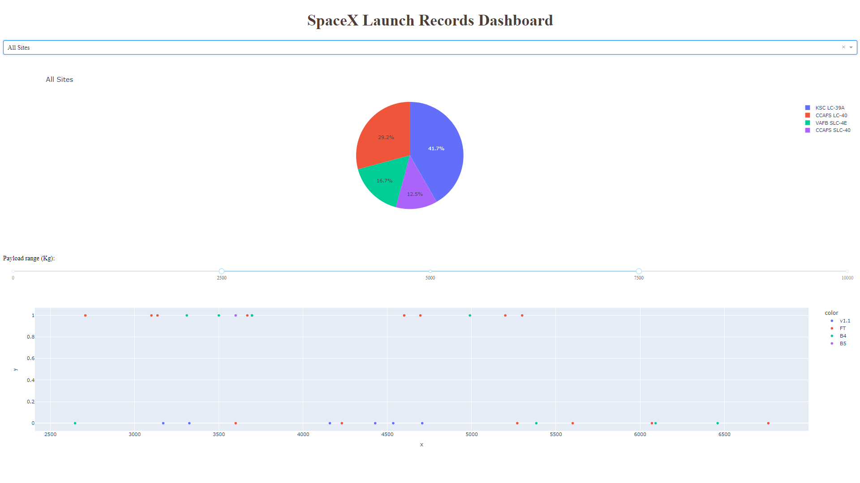
Original Dashboard

Slide 40
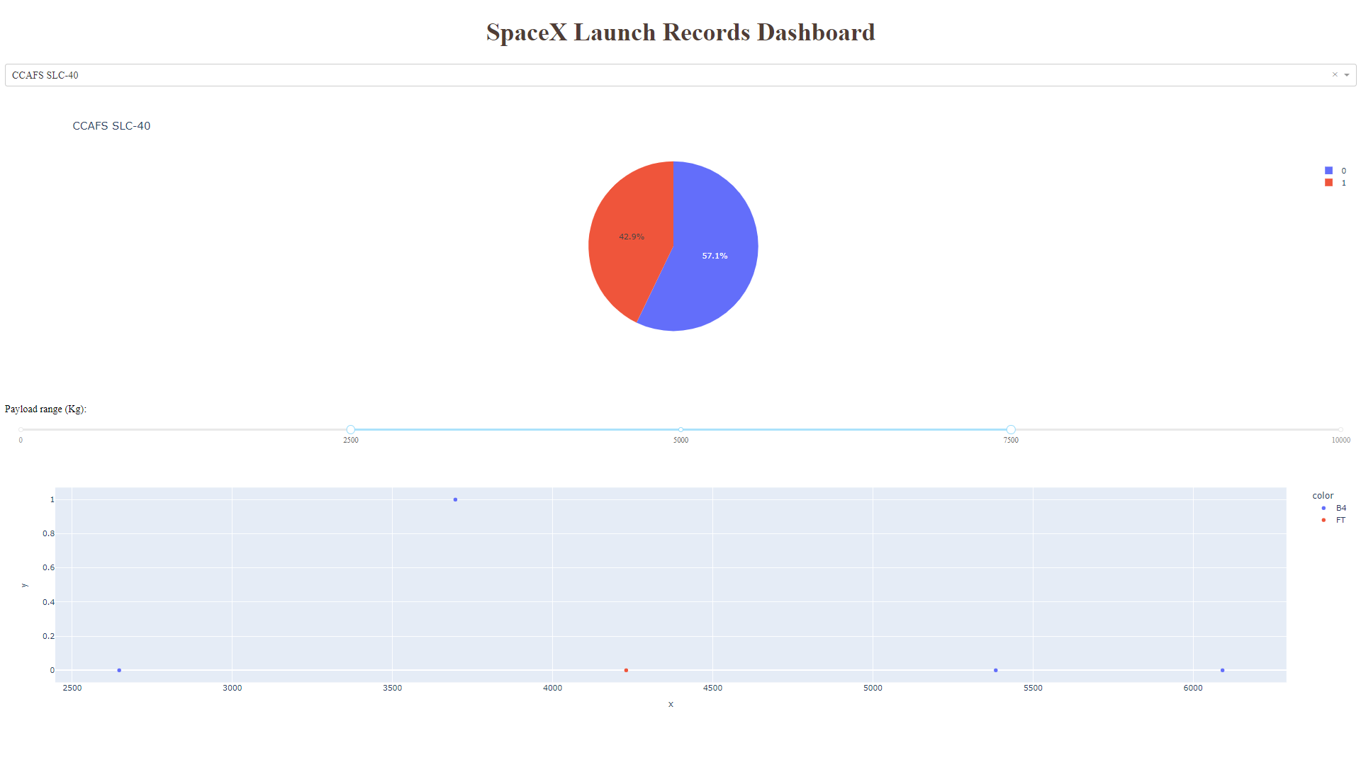
Dashboard for CCAFS SLC 40

Slide 41
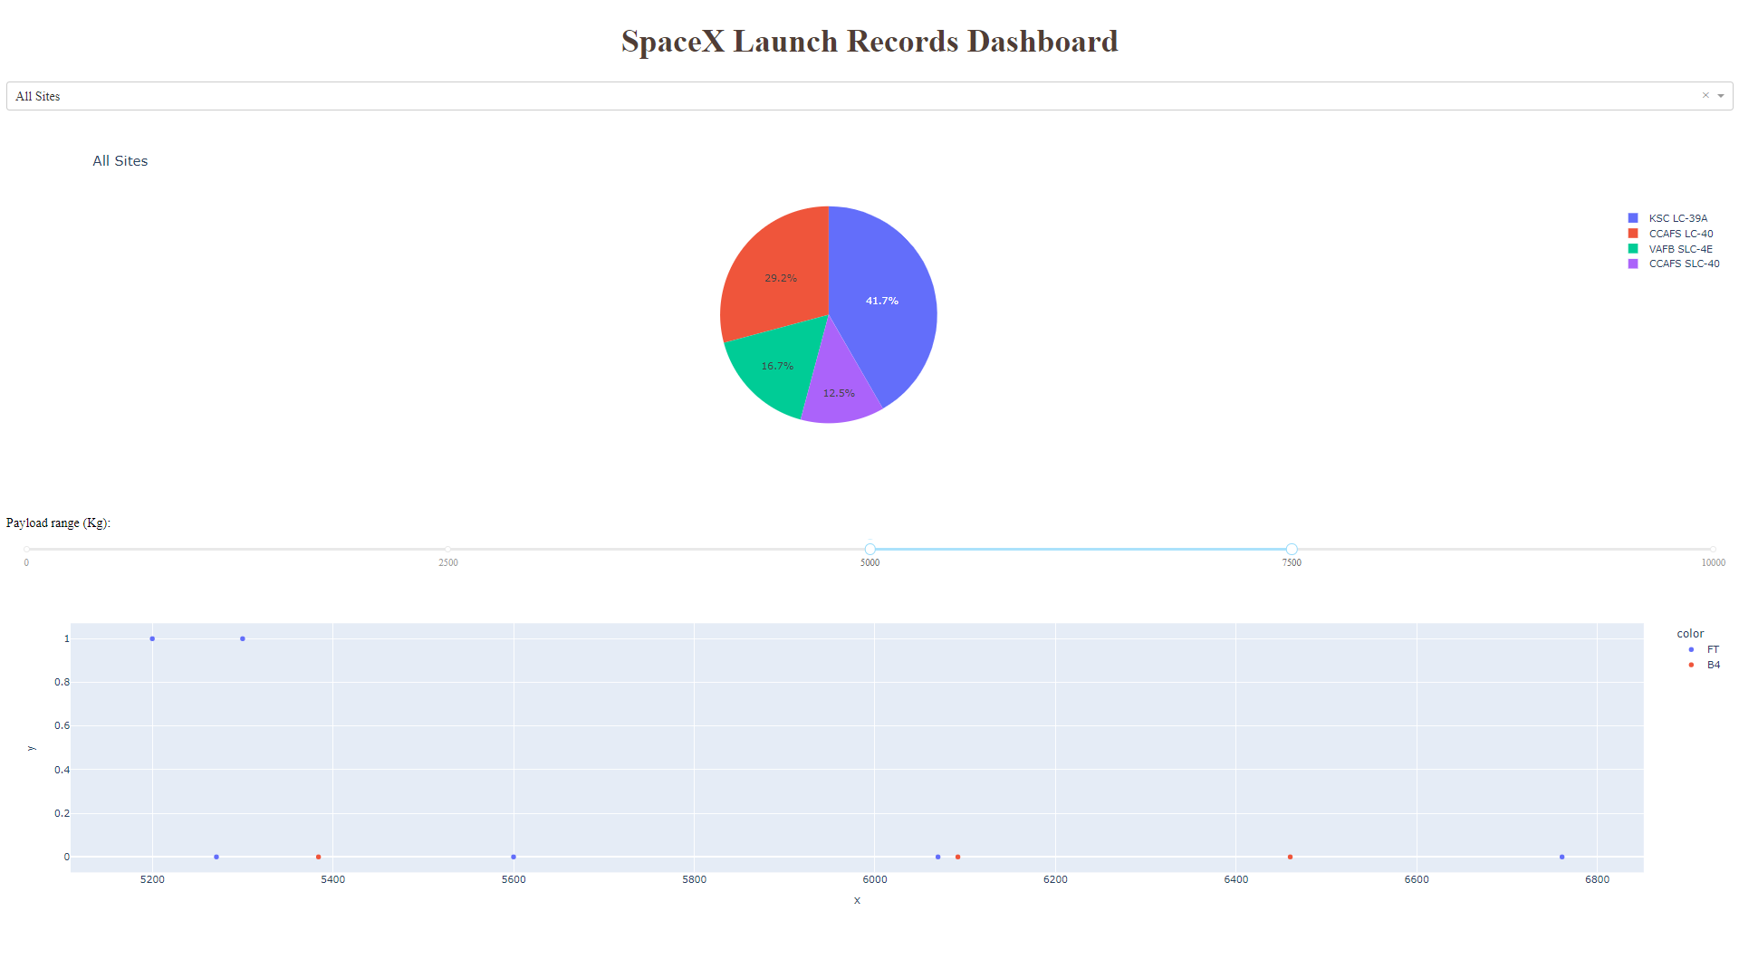
Dashboard for changed time period

Slide 42

Section 5

Slide 43
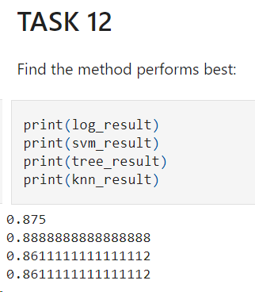
Classification Accuracy
The svm classifier is the model with the highest classification accuracy

Slide 44
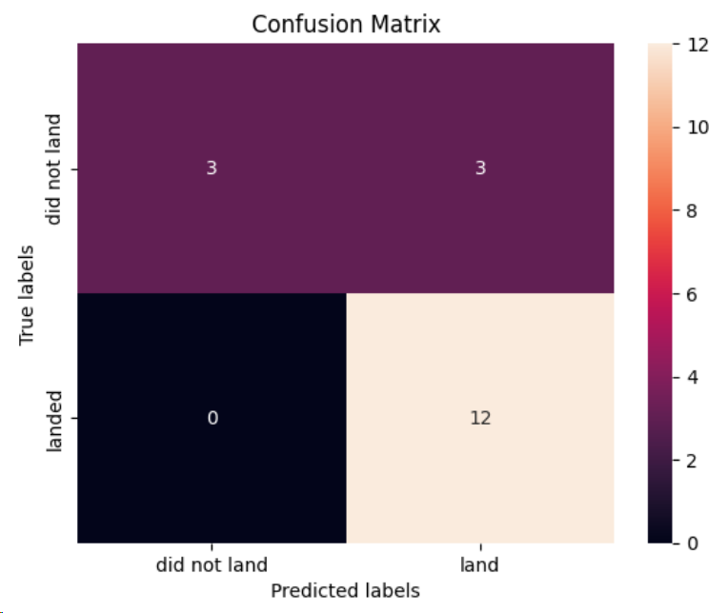
Confusion Matrix
The confusion matrix for the svm classifier shows that the classifier can distinguish between the different classes. The major problem is the false positives .i.e., unsuccessful landing marked as successful landing by the classifier.

Slide 45
Conclusions
We can conclude that:
The larger the flight amount at a launch site, the greater the success rate at a launch site.
Launch success rate started to increase in 2013 till 2020.
Orbits ES-L1, GEO, HEO, SSO, VLEO had the most success rate.
KSC LC-39A had the most successful launches of any sites.
The Decision tree classifier is the best machine learning algorithm for this task.

Slide 46


